Slide 1
Use Controls in Reports and Forms
Microsoft Access 2013
Lesson 8

Slide 2
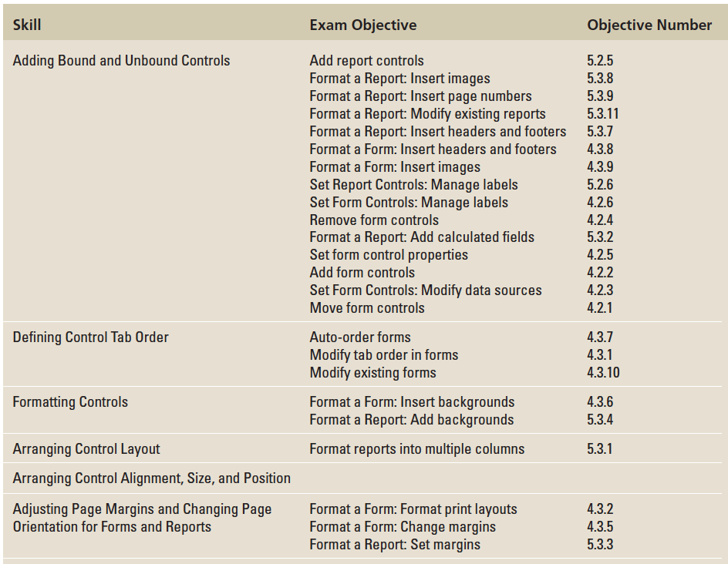
Objectives

Slide 3
Step by Step: Add Unbound Controls
GET READY. Before you begin these steps, be sure to turn on and/or log on to your computer and LAUNCH Access.
OPEN WingtipInventory from the data files for this lesson.
SAVE the database as WingtipInventoryXXX (where XXX is your initials).
Double-click the Toy Summary report in the Navigation Pane.
On the HOME tab, in the Views group, click the lower half of the View button and select Design View from the menu.
On the DESIGN tab, in the Header/Footer group, click the Logo button. The Insert Picture dialog box appears.

Slide 4
Step by Step: Add Unbound Controls
Navigate to the data files for this lesson and select Toys.jpg. Click OK. The picture is inserted in the Report Header section.
On the DESIGN tab, in the Header/Footer group, click the Title button. The title control with the title Toy Summary is inserted in the Report Header section. The text in the title is selected.
Key Inventory Summary by Toy and [press the Enter key].
Notes:
Take Note: Throughout this lesson you will see information that appears in black text within brackets, such as [Press Enter], or [your e-mail address]. The information contained in the brackets is intended to be directions for you rather than something you actually type word-for-word. It will instruct you to perform an action or substitute text. Do not type the actual text that appears within brackets.

Slide 5
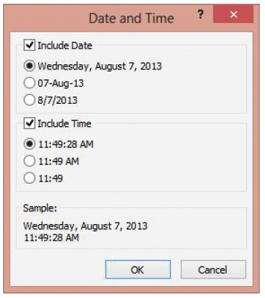
Step by Step: Add Unbound Controls
On the DESIGN contextual tab, in the Header/Footer group, click the Date and Time button. The Date and Time dialog box appears, as shown at right.

Slide 6
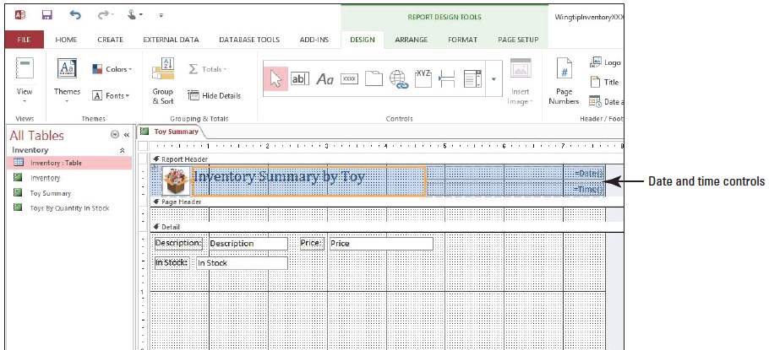
Step by Step: Add Unbound Controls
Click OK to accept the default date and time formats. The Date and Time controls are inserted in the Report Header section of the report, as shown below.

Slide 7
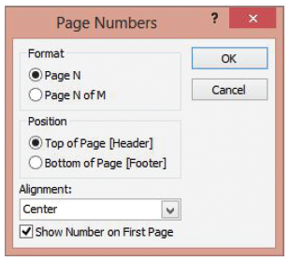
Step by Step: Add Unbound Controls
On the DESIGN contextual tab, in the Header/Footer group, click the Page Numbers button. The Page Numbers dialog box appears, as shown at right.

Slide 8
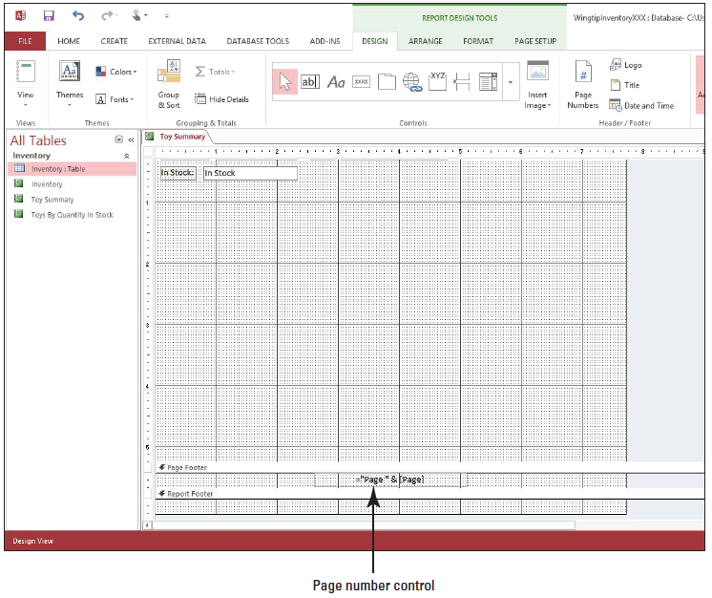
Step by Step: Add Unbound Controls
In the Position section of the Page Numbers dialog box, select the Bottom of Page [Footer] option then click OK. If necessary, scroll to the bottom of the report window. The Page number control is inserted in the Page Footer section near the bottom of the report, as shown below.
Click the Save button on the Quick Access Toolbar.
PAUSE. LEAVE the report open to use in the next exercise.

Slide 9
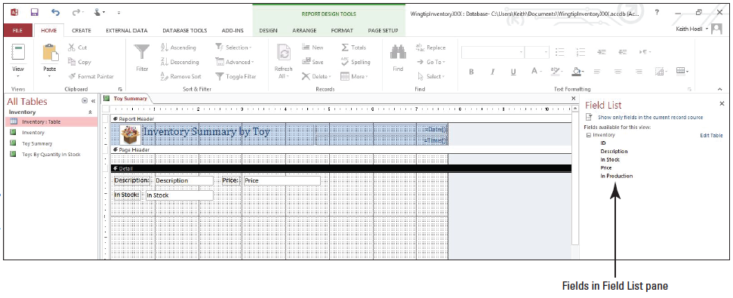
Step by Step: Add a Bound Control to a Report
USE the database that is open from the previous exercise.
On the DESIGN contextual tab, in the Tools group, click the Add Existing Fields button. The Field List pane appears. Click the Show all tables link. The fields for the Inventory table appear, as shown below.

Slide 10
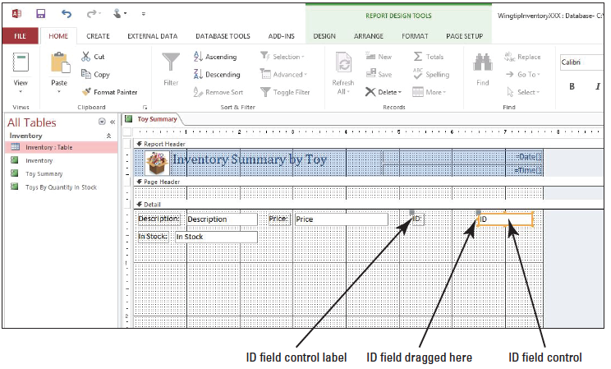
Step by Step: Add a Bound Control to a Report
Click the ID field and drag it to the right of the Price control, as shown below.

Slide 11
Step by Step: Add a Bound Control to a Report
Drag the In Production field to the design grid below the ID control.
Click Close on the Field List pane.
Click the ID field control until you see the orange border with selection handles on the borders and corners.
Right-click in the control to display the shortcut menu.

Slide 12
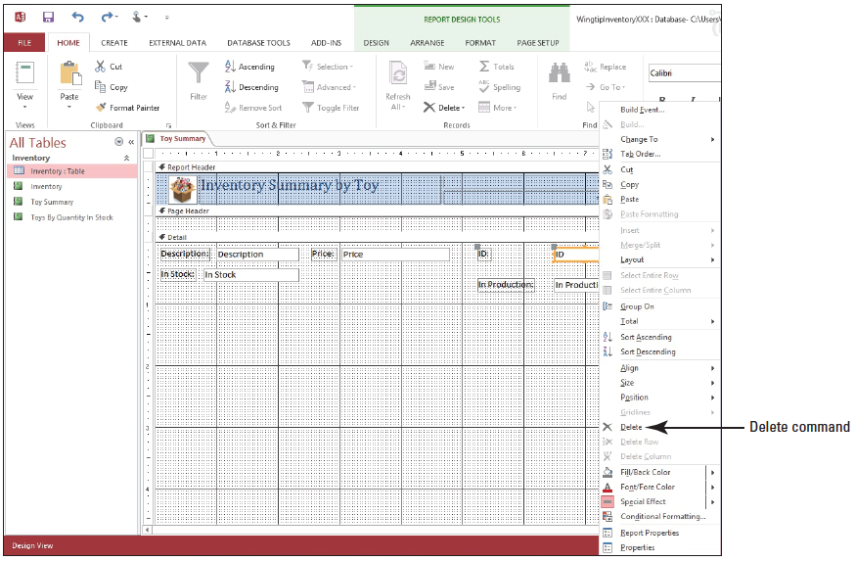
Step by Step: Add a Bound Control to a Report
Select Delete from the menu, as shown below. The control and label are removed from the design grid.
Notes:
Another Way: You can also use the arrow keys on the keyboard to move a control after it has been selected.

Slide 13
Step by Step: Add a Bound Control to a Report
Select the In Production control, right-click, and select Delete from the menu.
On the DESIGN contextual tab, in the Controls group, click the Text Box button. The mouse pointer changes to the move pointer with a plus sign (+).

Slide 14
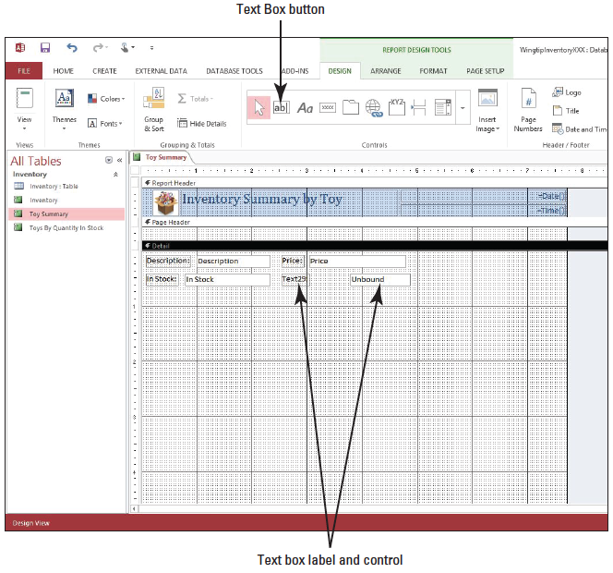
Step by Step: Add a Bound Control to a Report
Position the pointer under the Price control and click to create the text box control as shown at right.
Select the text box control if it isn’t already selected.
On the DESIGN contextual tab, in the Tools group, click the Property Sheet button. The Property Sheet appears.
Notes:
If you need to move the control, select it and move the mouse pointer over the selection border until it appears as a four-sided pointer, then click and drag it to the appropriate location. Notice that the word Unbound is shown in the control and the word Text and a number (depending on the number of controls you have created in this session) appear in the label.

Slide 15
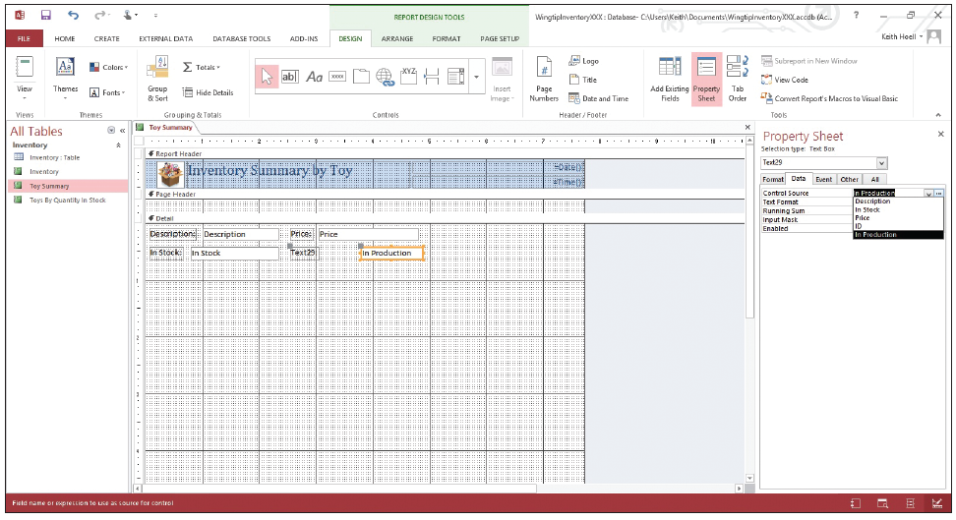
Step by Step: Add a Bound Control to a Report
In the DATA tab, click the down arrow on the Control Source row and click the In Production field, as shown below. Notice the control now displays the field name In Production, which means that it is now bound to the control.
Click Close on the Property Sheet.

Slide 16
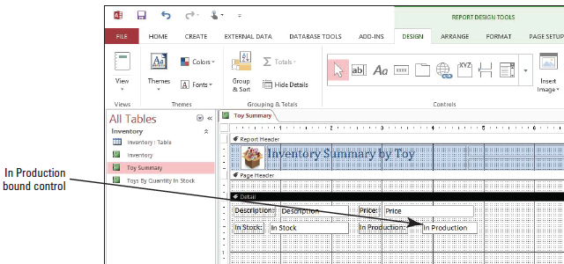
Step by Step: Add a Bound Control to a Report
Click the In Production control label and select the text in the label.
Key In Production: and then [press Enter]. Your screen should look similar to the figure below.

Slide 17
Step by Step: Add a Bound Control to a Report
Switch to Report view to view your changes. When finished, switch back to Design view.
Click the Save button on the Quick Access Toolbar.
PAUSE. LEAVE the report open to use in the next exercise.
Notes:
Take Note: The process for setting report control properties is the same for a form. Once shown how to set a report control property, you can set a form control property in the same manner.

Slide 18
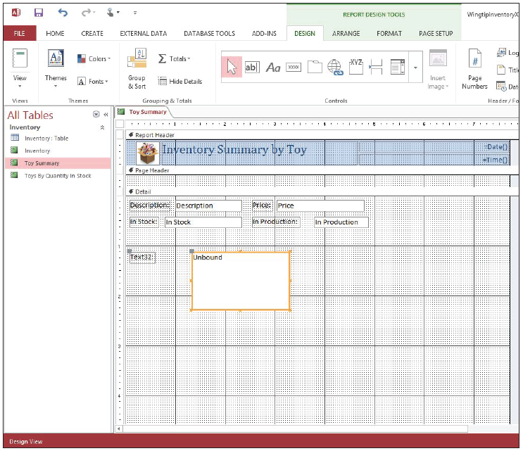
Step by Step: Add a Calculated Control
USE the database that is open from the previous exercise.
On the DESIGN tab, in the Controls group, click the Text Box button.
Position the mouse pointer on the design grid and drag down and to the right to create and position a control the size of the one shown at right.

Slide 19
Step by Step: Add a Calculated Control
With the control selected, right-click it to display the shortcut menu.
Select Properties from the menu to display the Property Sheet if it isn’t already displayed.
On the DATA tab, in the Control Source row, click the Build button. The Expression Builder dialog box appears.

Slide 20
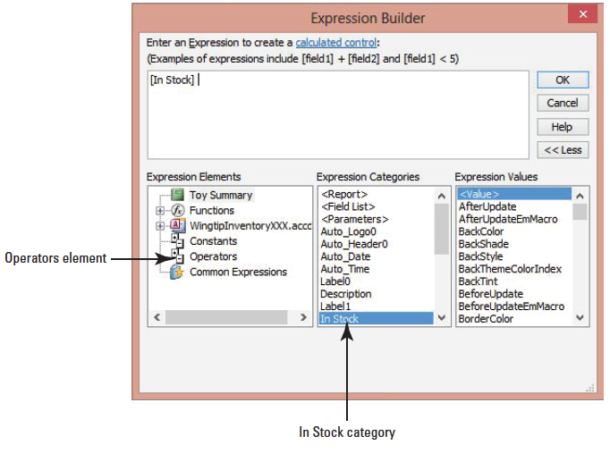
Step by Step: Add a Calculated Control
In the Expression Categories list, scroll down and double-click In Stock, as shown at right. The In Stock field is inserted in the expression box.
Notes:
Take Note: All the list items in the Expression Categories on your screen may not match exactly to the figure shown.

Slide 21
Step by Step: Add a Calculated Control
In the Expression Elements section, click the Operators element, then double-click the * asterisk value in the Expression Values section to select the multiplication operator.
In the Expression Elements section, click the Toy Summary element, then find and double-click the Price field in the Expression Categories section.

Slide 22
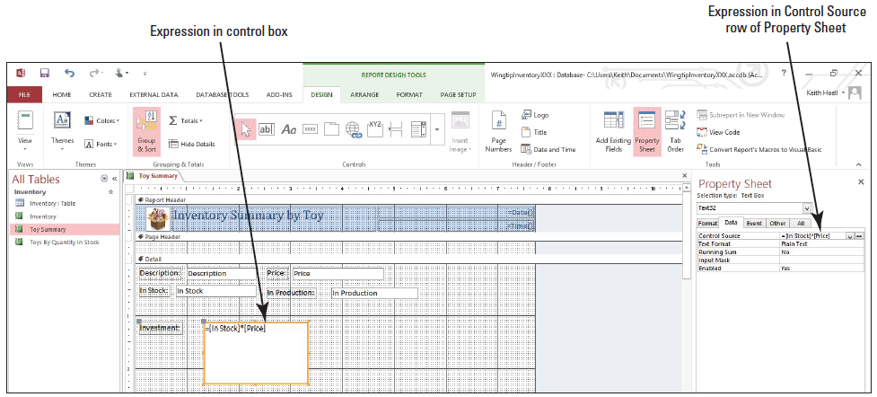
Step by Step: Add a Calculated Control
Click OK. The expression appears in the Control Source row of the Property Sheet as well as in the control box in the Detail section of the report, as shown below.
Click Close on the Property Sheet.

Slide 23
Step by Step: Add a Calculated Control
Select the text in the label and key Investment:.
Switch to Report view and scroll through the report records to view the calculated totals.
Click the Save button on the Quick Access Toolbar.
CLOSE the report.
PAUSE. LEAVE the database open to use in the next exercise.
Notes:
Take Note: It is often easiest to add and arrange all the bound controls first, and then add the unbound and calculated controls to complete the design of the report.

Slide 24
Step by Step: Use the Control Wizard
USE the database that is open from the previous exercise.
On the CREATE tab, in the Forms group, click the Form Design button. A new, blank form is created, and the Field List pane is displayed. (If it isn’t, click the Add Existing Fields button in the Tools group on the Ribbon.)
If necessary, click Show all tables link in the Field List pane and then click the expand button next to Inventory to display the fields of the Inventory table.
Double-click the Description field to add it to the form.
Double-click the In Stock field to add it to the form.
Double-click the Price field to add it to the form.
Double-click the In Production field to add it to the form.

Slide 25
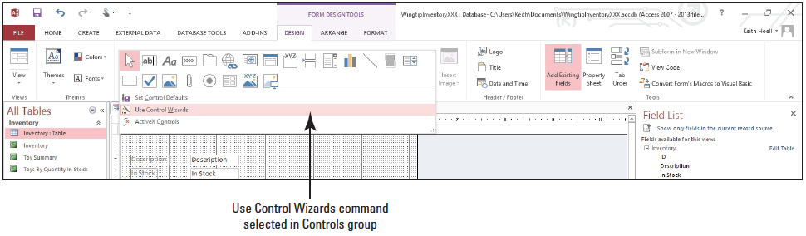
Step by Step: Use the Control Wizard
Select the In Production control that you just added, right-click it and select Delete from the shortcut menu.
On the DESIGN tab, in the Controls group, locate the Use Control Wizards command and make sure it is turned on, as shown below. The image to the left of the command should be highlighted.

Slide 26
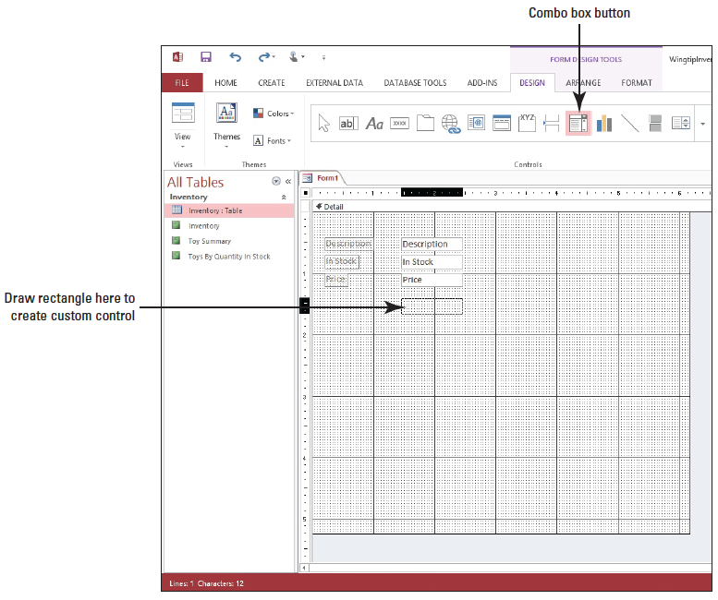
Step by Step: Use the Control Wizard
On the DESIGN tab, in the Controls group, locate and click the Combo Box button (hover your mouse pointer over each control button to view its ScreenTip until you find the Combo Box button).
Position the mouse pointer and drag to draw a rectangle, as shown at right.

Slide 27
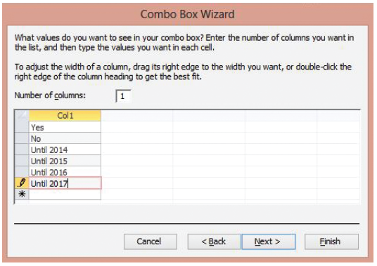
Step by Step: Use the Control Wizard
When you release the mouse button, the Combo Box Wizard appears. Click the button beside I will type in the values that I want and click Next>. In the empty cell below the Col1 header, key Yes. Continue keying values in the column as shown at right using the down arrow key to move to the next row.

Slide 28
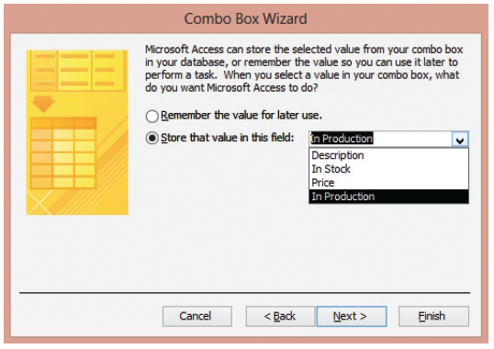
Step by Step: Use the Control Wizard
Click Next >.
Click the button beside Store that value in this field and click the down arrow to display the menu. Select In Production from the menu, as shown at right.

Slide 29
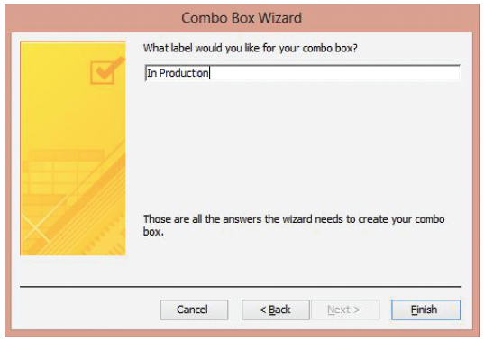
Step by Step: Use the Control Wizard
Click Next >.
Key In Production in the text box, as shown at right.

Slide 30
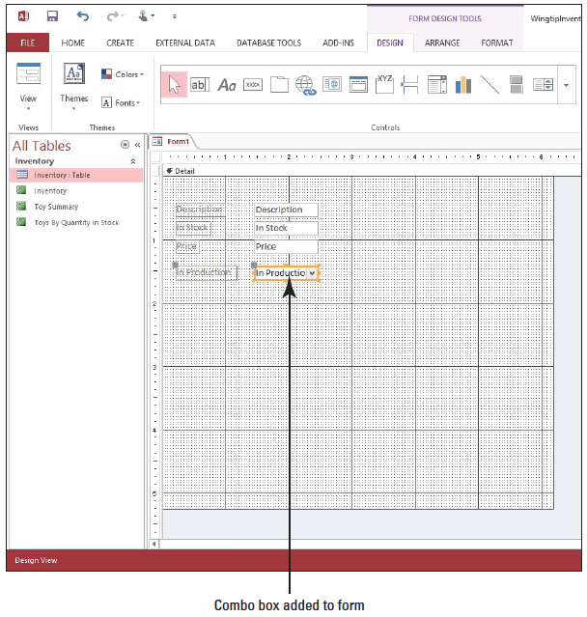
Step by Step: Use the Control Wizard
Click Finish. Your screen should look similar to the figure at right.
Notes:
Take Note: A combo box is also known as a drop-down control, because it is a combination of a text box with a list box that is hidden until you select the arrow next to the text box and it drops down.

Slide 31
Step by Step: Use the Control Wizard
Switch to Form view, scroll through the records, and modify the In Production field by selecting an item in the combo box for one or more records.
Click the Save button on the Quick Access Toolbar and SAVE the form as Inventory.
PAUSE. LEAVE the form open to use in the next exercise.

Slide 32
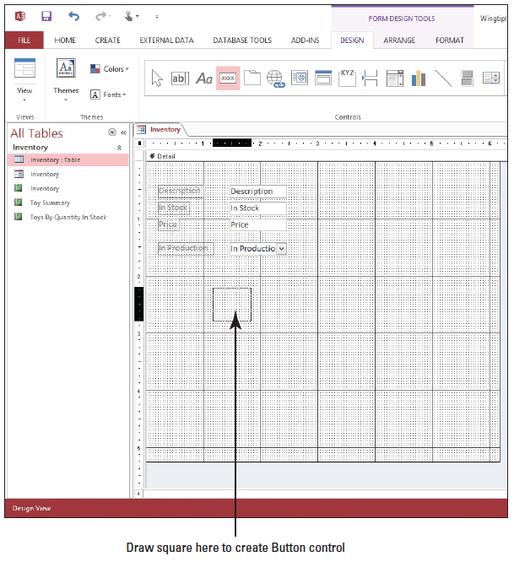
Step by Step: Use the Control Wizard to Add Button Controls
USE the form that is open from the previous exercise.
Switch to Design view, if necessary.
On the DESIGN tab, in the Controls group, click the Button button.
Position the mouse pointer on the design grid and drag down and to the right to create a control the size of the one shown at right.

Slide 33
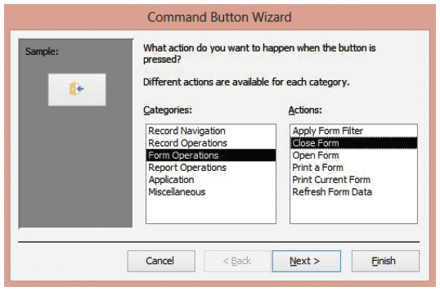
Step by Step: Use the Control Wizard to Add Button Controls
When you release the mouse button, the Command Button Wizard appears. In the Categories: section, click Form Operations, and in the Actions: section click Close Form, as shown at right.
Click Next >.

Slide 34
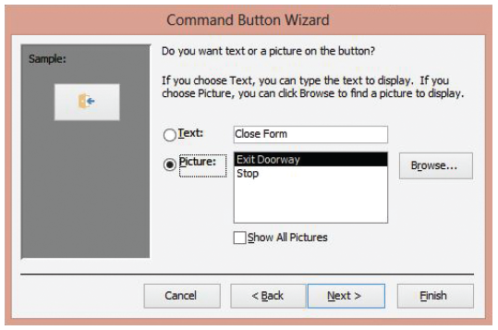
Step by Step: Use the Control Wizard to Add Button Controls
On the next screen, keep the default settings to have the button contain the Exit Doorway picture displayed in the dialog box, as shown at right.
Click Next >.

Slide 35
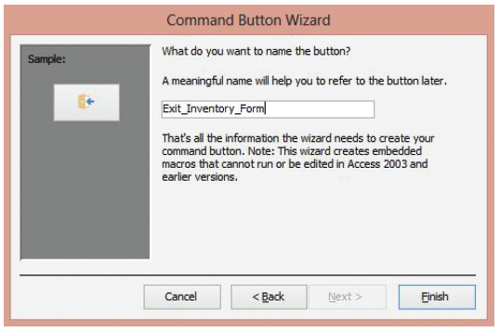
Step by Step: Use the Control Wizard to Add Button Controls
On the final screen, key Exit_Inventory_Form as the default button name, as shown at right, and click Finish. (The default button name indicated on your screen may differ depending on how many controls you have previously attempted to include.)
Notice that the image on the Button control on the form has changed to the Exit Doorway picture.

Slide 36
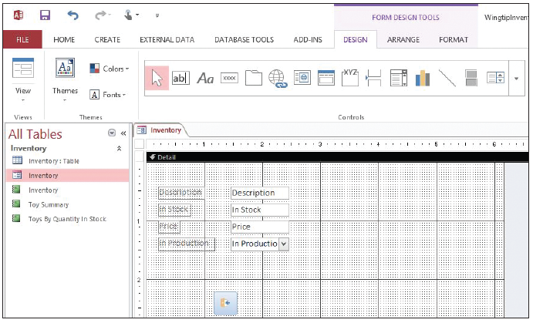
Step by Step: Use the Control Wizard to Add Button Controls
Click the In Production control and move your pointer over the control’s border until it appears as a four-sided arrow, then drag the control so it is positioned on the form as shownbelow, if necessary.
Click the Save button on the Quick Access Toolbar.

Slide 37
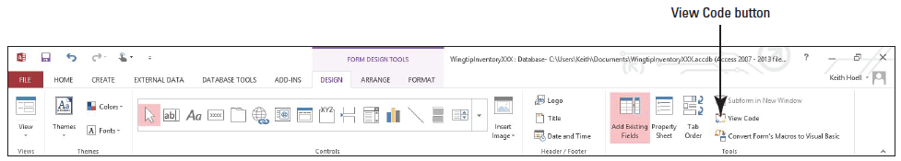
Step by Step: Use the Control Wizard to Add Button Controls
Click the Button control on the form. On the DESIGN tab, in the Tools group, click the View Code button, as shown below.

Slide 38
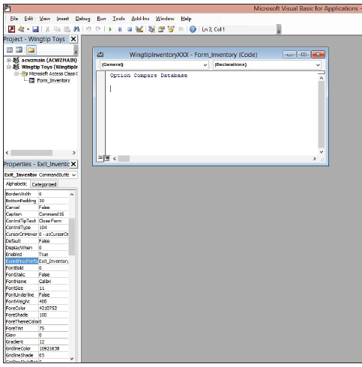
Step by Step: Use the Control Wizard to Add Button Controls
The Microsoft Visual Basic for Applications window appears, as shown at right. If you’re fluent in Visual Basic for Applications (VBA), you can use this window to add VBA code to customize the function of this control.

Slide 39
Step by Step: Use the Control Wizard to Add Button Controls
Click the Close button on the Visual Basic for Applications window to return to Access.
Switch to Form view and click the newly created Close Form button to close the form. If a dialog box appears asking you if you want to SAVE the changes to the form, click Yes.
PAUSE. LEAVE the database open to use in the next exercise.
Notes:
Another Way: You can also right-click the design grid in Design view to access the Tab Order dialog box.

Slide 40
Step by Step: Define Control Tab Order
USE the database you used in the previous exercise.
Open the Inventory form in Form view.
[Press the Tab key] several times to see the order in which the controls are selected each time you press it. Notice that the tab order begins with the Description field, then moves to the In Stock field, the Price field, the In Production field, and the Close Form button. The tab order then continues to the next record in sequence and through the same fields as before.
Switch to Design view.

Slide 41
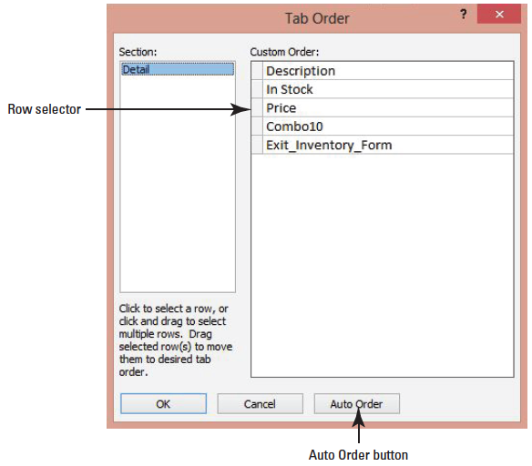
Step by Step: Define Control Tab Order
On the DESIGN tab, in the Tools group, click the Tab Order button. The Tab Order dialog box appears, displaying the tab order in the Custom Order list, as shown at right. Notice the In Production combo box field is referred to as Combo10 since Access stores this name to use as a coding reference in Visual Basic for Applications.
Click the row selector to the left of the Combo10 field to select it.
Notes:
(You may have a different name, depending on how many controls you have had and removed previously on the form.)

Slide 42
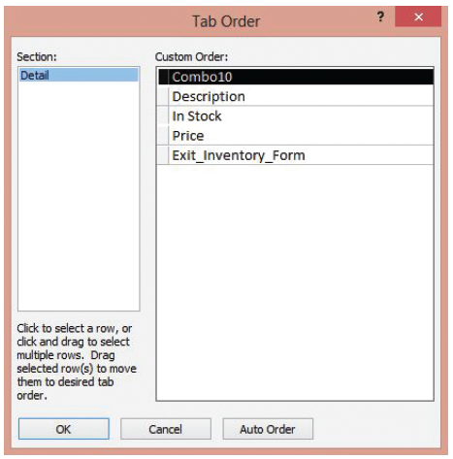
Step by Step: Define Control Tab Order
Click and hold the row selector. The mouse pointer changes to a move pointer with an empty rectangle. Drag up a row and notice the black horizontal line moves with you. Drag up until the black horizontal line is in place at the top of the Description field; release the mouse button. The Combo10 field should be the first item in the list, as shown at right.

Slide 43
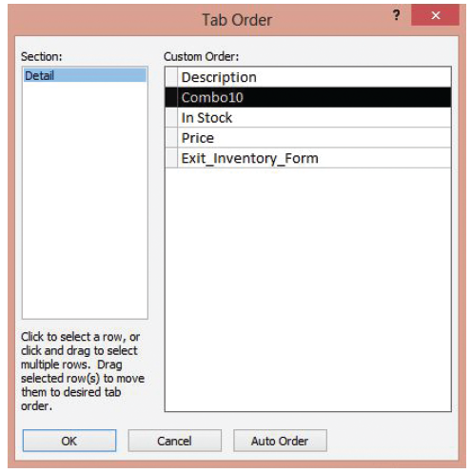
Step by Step: Define Control Tab Order
Click the Auto Order button. The order of the fields auto- matically resets based on the order that they appear on the form or report.
Click the row selector to the left of the Combo10 field to select it. Click and hold the row selector and drag it up until the black horizontal line is in place above the In Stock field; release the mouse button. The Combo10 field should now be the second item in the list, as shown above.

Slide 44
Step by Step: Define Control Tab Order
Click OK.
SAVE the form design.
Switch to Form view.
[Press the Tab key] several times to see the new tab order.
CLOSE the form.
PAUSE. LEAVE the database open to use in the next exercise.

Slide 45
Step by Step: Format Controls on a Report
USE the database that is open from the previous exercise.
Open the Toy Summary report and switch to Design view.
Click the In Stock control. Position the mouse pointer over the resize handle on the right border. The mouse pointer changes to a double-sided arrow. Using the horizontal ruler at the top of the report as a guide, drag to the left to resize the control until its right side is at the 16/8” mark.
In the same manner, reduce the width of the Price control until its right side is at the horizontal ruler’s 4” mark.

Slide 46
Step by Step: Format Controls on a Report
In the same manner, reduce the size of the Investment control until its right side is at the horizontal ruler’s 21/2” mark and its bottom is at the vertical ruler’s 11/2” mark.
Click the Description control to select it.
On the FORMAT tab, in the Font group, click the Bold button. The Description control displays bold.
Click the arrow on the Font Size menu and select 12 from the menu. The font size becomes 12.
Click the In Stock control to select it.

Slide 47
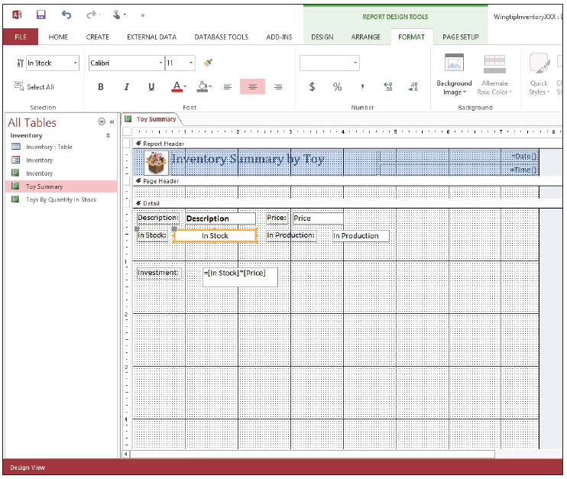
Step by Step: Format Controls on a Report
On the FORMAT tab, in the Font group, click the Center button. The In Stock text becomes centered in the control box. Your report should look similar to the figure at right.
Click the Investment control that contains the formula you entered in an earlier exercise.

Slide 48
Step by Step: Format Controls on a Report
On the FORMAT tab, in the Number group, click the Apply Currency Format command.
Click the Price control.
On the FORMAT tab, in the Number group, click the Apply Currency Format command.
SAVE the report.
Switch to Report view to see the changes you’ve made. Notice the text formatting changes as well as the currency formats for the Investment and Price fields.

Slide 49
Step by Step: Format Controls on a Report
CLOSE the report.
OPEN the Toys By Quantity In Stock report in Design view.
In the Report Header section, click the Print Report Button control to select it.
On the FORMAT tab, in the Control Formatting group, click the Change Shape button to display the menu. Click the Oval option. The Button control’s shape changes to an oval.
SAVE and CLOSE the report.
PAUSE. LEAVE the database open to use in the next exercise.

Slide 50
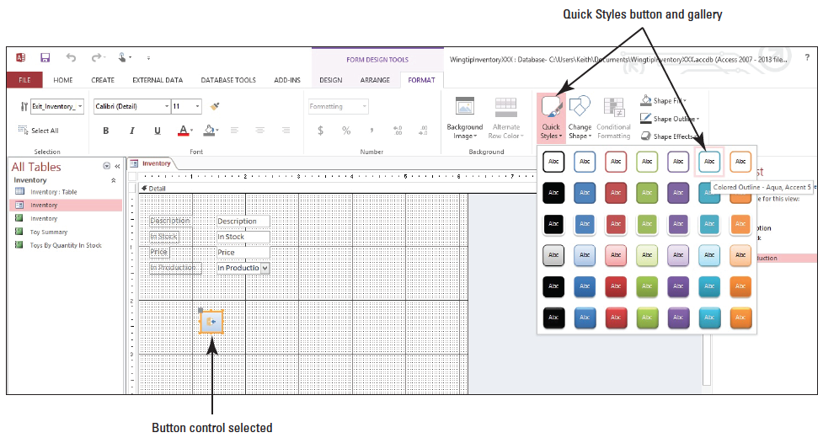
Step by Step: Format the Controls on a Form
USE the database that is open from the previous exercise.
Open the Inventory form if it’s not open already, and switch to Design view.
Click the Button control on the form. On the FORMAT tab, in the Control Formatting group, click the Quick Styles button to display the Quick Styles gallery. Click the Colored Outline—Aqua, Accent 5 Quick Style, as shown above. The Button control’s style changes to the chosen Quick Style.

Slide 51
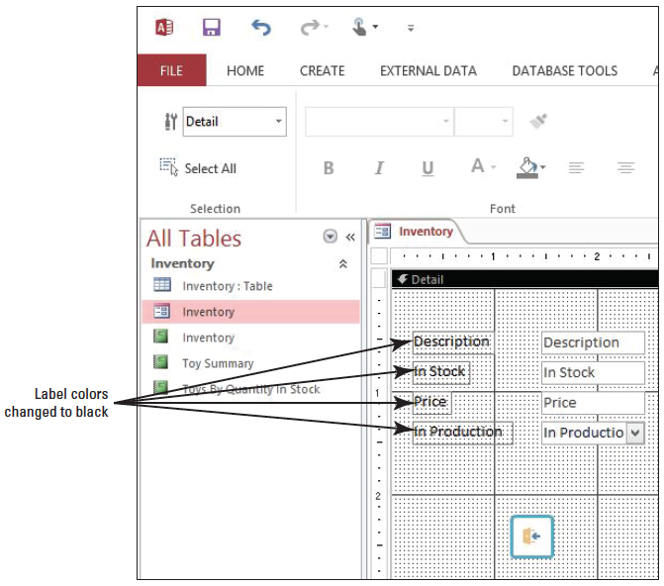
Step by Step: Format the Controls on a Form
Click the Description label to select it.
On the FORMAT tab, in the Font group, click the Font Color button and click Black from the Theme Colors menu. The Description label displays in black. Change the font color to black for the In Stock, Price, and In Production labels. Your screen should resemble the figure at right.

Slide 52
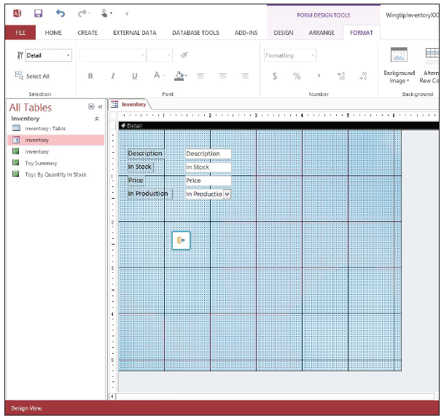
Step by Step: Format the Controls on a Form
On the FORMAT tab, in the Background group, click the Background Image button and click the Browse command to locate the Winter Theme Background.jpg image file and click OK. Notice the form’s background image is now that of the image, as shown at right.

Slide 53
Step by Step: Format the Controls on a Form
Switch to Form view to see the changes you made.
SAVE and CLOSE the form.
PAUSE. LEAVE the database open to use in the next exercise.
Notes:
Take Note: The process for adding a background image to a form or a report is the same. Once shown how to add a background image to a form, you can add a background image to a report in the same manner.

Slide 54
Step by Step: Create Conditional Formatting
USE the database you used in the previous exercise.
Open the Toy Summary report, if necessary, and switch to Design view.
Click the In Stock control to select it.
On the FORMAT tab, in the Control Formatting group, click the Conditional Formatting button. The Conditional Formatting Rules Manager dialog box appears.
Click the New Rule button. The New Formatting Rule dialog box appears. You will create a new rule based on criteria you will enter.

Slide 55
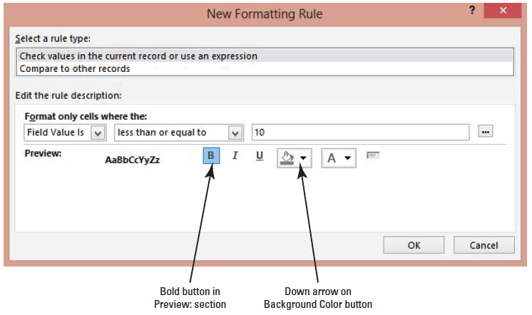
Step by Step: Create Conditional Formatting
In the Edit the rule description: section, keep Field Value Is in the first menu. Click the drop-down arrow to the right of between and scroll to the bottom of the list to select less than or equal to. Click in the empty text box and key 10. Click the Bold button in the Preview: section. Your screen should look similar to the figure below.

Slide 56
Step by Step: Create Conditional Formatting
Click the down arrow on the Background Color button. A menu of colors appears. Click Red.
Click the OK button. A formatting rule for the In Stock field is added to the dialog box. Now, when the report is viewed in Report view, the value for the In Stock field will appear bold and the control background color will appear red if the formatting rule applies.
Click OK.
SAVE the report.
Switch to Report view and scroll through the records to see the conditional formatting at work.
CLOSE the report.
PAUSE. LEAVE the database open to use in the next exercise.

Slide 57
Step by Step: Arrange Control Layout
USE the database that is open from the previous exercise.
Click the Inventory table in the Navigation Pane to select it.
On the CREATE tab, in the Reports group, click the Blank Report button. A new, blank report is created and the Field List pane is displayed. (If it isn’t, click the Add Existing Fields button in the Tools group on the DESIGN tab.)
Double-click the ID field to add it to the report.
Double-click the Description field to add it to the report.
Double-click the In Stock field to add it to the report.
Double-click the Price field to add it to the report.

Slide 58
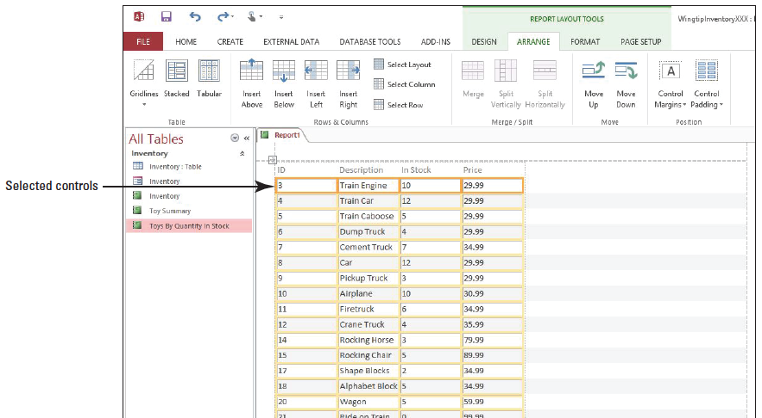
Step by Step: Arrange Control Layout
[Press and hold the Shift key] and click each of the four controls to select them all. Make sure you select the controls and not the labels, as shown below.

Slide 59
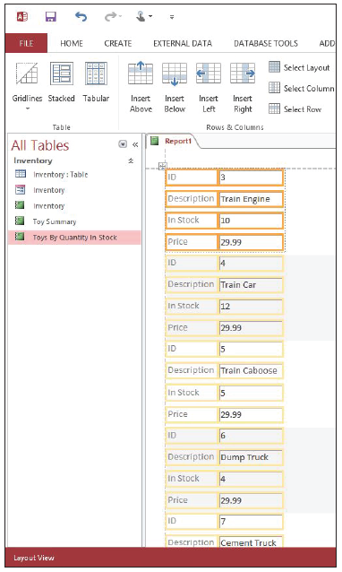
Step by Step: Arrange Control Layout
On the ARRANGE tab, in the Table group, click the Stacked button. The controls and labels are arranged in a 2-column stacked layout, as shown at right.

Slide 60
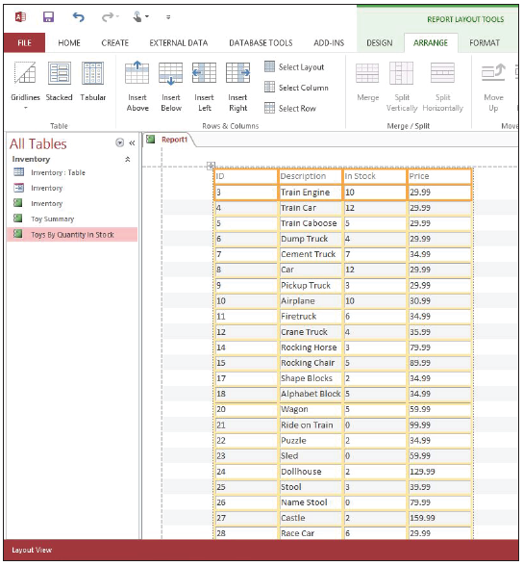
Step by Step: Arrange Control Layout
On the ARRANGE tab, in the Table group, click the Tabular button. The controls and labels are arranged back in a tabular layout, as shown at right. Notice the tabular format indented the position of the columns by default.

Slide 61
Step by Step: Arrange Control Layout
On the ARRANGE tab, in the Table group, click the Stacked button to switch it back to a stacked layout.
SAVE the report as Stacked Report and leave it open for use in the next exercise.
PAUSE. LEAVE the database open to use in the next exercise.

Slide 62
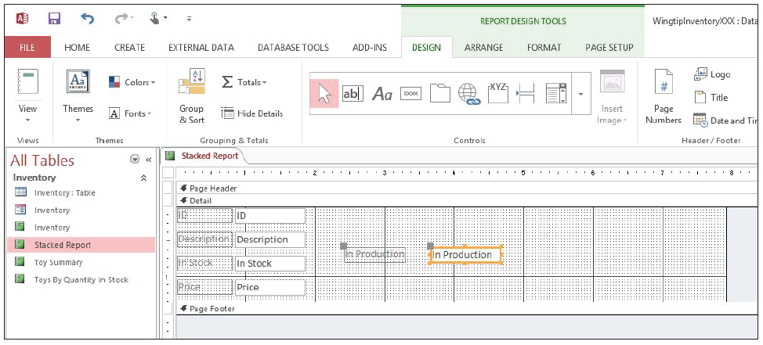
Step by Step: Add, Move, and Remove a Control from a Layout
USE the database that is open from the previous exercise.
Switch to Report Design view, if necessary.
Click the Show all tables link in the Field List pane, if necessary, to view all the available fields in the Inventory table.
Click the In Production field in the Field List pane. Drag it to the grid and place it in any location on the design grid to the right of the four controls. Your screen should look similar to the figure at right.

Slide 63
Step by Step: Add, Move, and Remove a Control from a Layout
[Press and hold the Shift key] and select the ID field control. Still [holding the Shift key], select the Description, In Stock, and Price field controls so that all five are selected.
On the ARRANGE tab, in the Table group, click the Stacked button. The In Production control is added to the bottom of the stacked layout.

Slide 64
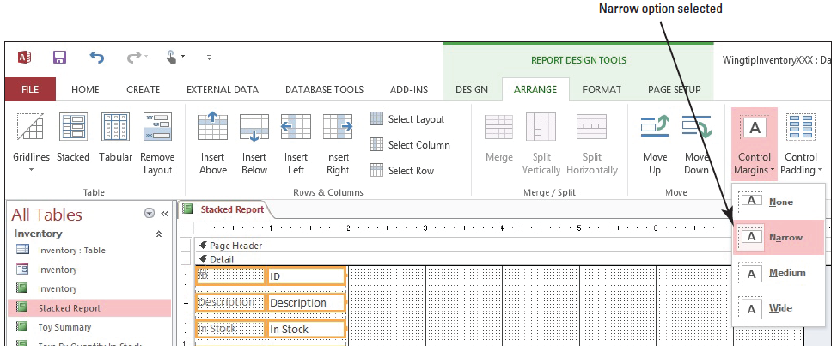
Step by Step: Add, Move, and Remove a Control from a Layout
With all five controls still selected, click the Control Margins button on the ARRANGE tab in the Position group, and select Narrow from the menu, as shown below. The text within the field controls and labels is formatted by the Narrow option.

Slide 65
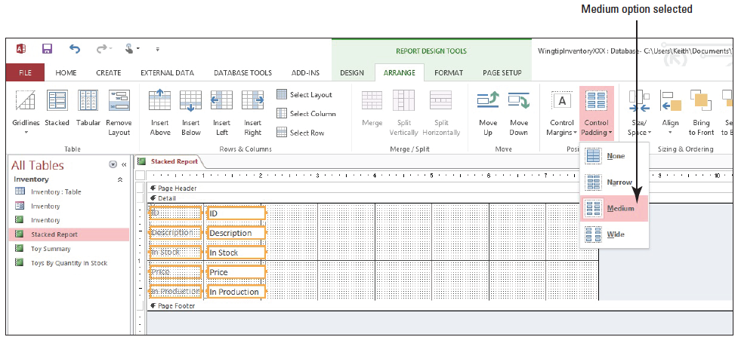
Step by Step: Add, Move, and Remove a Control from a Layout
On the ARRANGE tab, in the Position group, click the Control Padding button and select Medium from the menu, as shown below.

Slide 66
Step by Step: Add, Move, and Remove a Control from a Layout
Click anywhere on a blank area of the design grid to deselect the field controls, then select the In Production field control and click Select Row in the Rows & Columns group. Notice the In Production label and field control are both outlined in orange. In the Move group on the Ribbon, click the Move Up button three times to move it under the ID label and field control.
Click and drag the ID control out of the layout. It will not move out of the layout.
Click anywhere on a blank area of the design grid to deselect the field controls, then [press and hold the Shift key] and select the Price label and control.

Slide 67
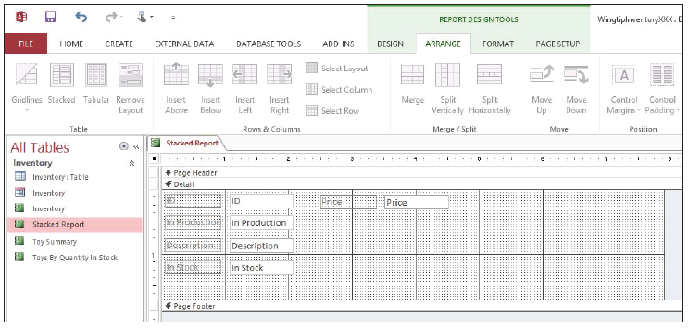
Step by Step: Add, Move, and Remove a Control from a Layout
In the Table group on the Ribbon, click the Remove Layout button.
Click and drag the Price field control to the right of the ID field control, as shown below.

Slide 68
Step by Step: Add, Move, and Remove a Control from a Layout
SAVE the report and switch to Report view to view your changes.
CLOSE the report.
PAUSE. LEAVE the database open to use in the next exercise.
Notes:
Take Note: If the In Production text within the label is partially hidden, switch to Design view and select the In Production control and label. On the ARRANGE tab, in the Position group, click the Control Margins button and select None from the menu, then SAVE the report.
Take Note: To select multiple controls, hold down the Shift key and then click the controls.

Slide 69
Step by Step: Arrange and Anchor Controls within a Layout
USE the database that is open from the previous exercise.
Click the Inventory table in the Navigation Pane to select it.
On the CREATE tab, in the Forms group, click the Form button. A new form containing all the fields from the Inventory table is created in Layout view. Notice the stacked control layout is the default.
Switch to Design view.
Click the ID control to select it.
On the ARRANGE tab, in the Merge/Split group, click the Split Horizontally button. Click to the right of the ID field control and notice the orange border of the new column created after the split.

Slide 70
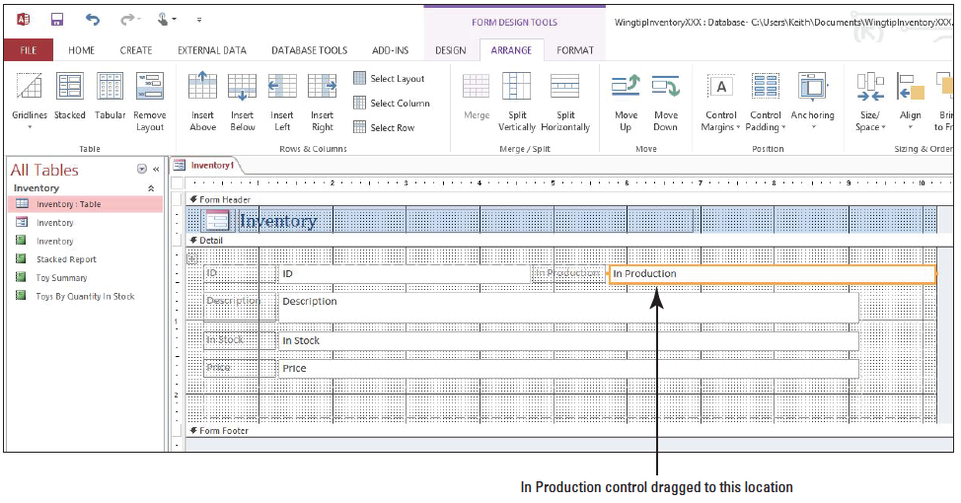
Step by Step: Arrange and Anchor Controls within a Layout
Click the In Production field control and drag it to the right of the ID field control to place it next to it. The In Production label and field control is now in the column. Your screen should resemble the figure below. Notice the new additional space automatically created to the right of the other field controls.
Notes:
Take Note: Access automatically creates a new column of placeholders in a layout when a field control is horizontally split and another field control is dragged into the placeholder created next to the horizontally split field control.

Slide 71
Step by Step: Arrange and Anchor Controls within a Layout
Click the In Stock field control to select it. [Press and hold the Shift key] and select the In Stock control label. On the ARRANGE tab, in the Move group, click the Move Down button once. The In Stock field control and label move to the bottom of the layout.

Slide 72
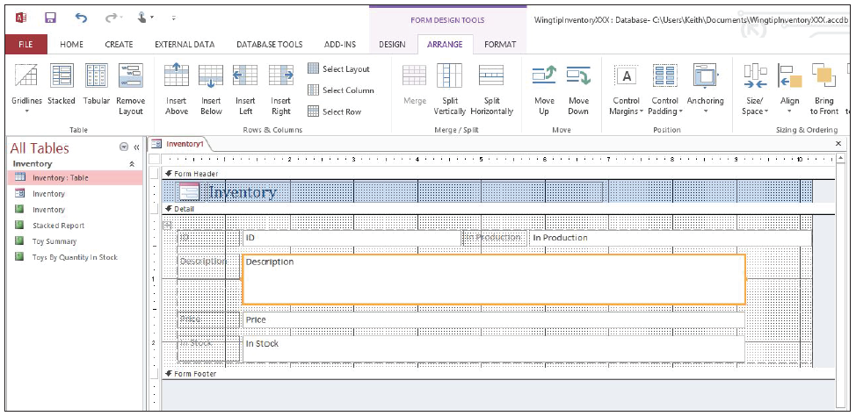
Step by Step: Arrange and Anchor Controls within a Layout
Click the Description field control to select it. [Press and hold the Shift key] and click the empty space below the Description field control to select the cell. Both the Description field control and cell below should be outlined in orange. On the ARRANGE tab, in the Merge/Split group, click the Merge button. The Description field control and cell have now merged into one, as shown below.

Slide 73
Step by Step: Arrange and Anchor Controls within a Layout
Click the In Stock field control to select it. On the ARRANGE tab, in the Rows & Columns group, click the Insert Below button twice. Two empty cells are added under the In Stock control. The In Stock field control should still be selected.
On the ARRANGE tab in the Rows & Columns group, click the Select Row button. Both the In Stock label and field control should be selected as well as an empty column created when we dragged the In Production field control to the right of the ID field control.

Slide 74
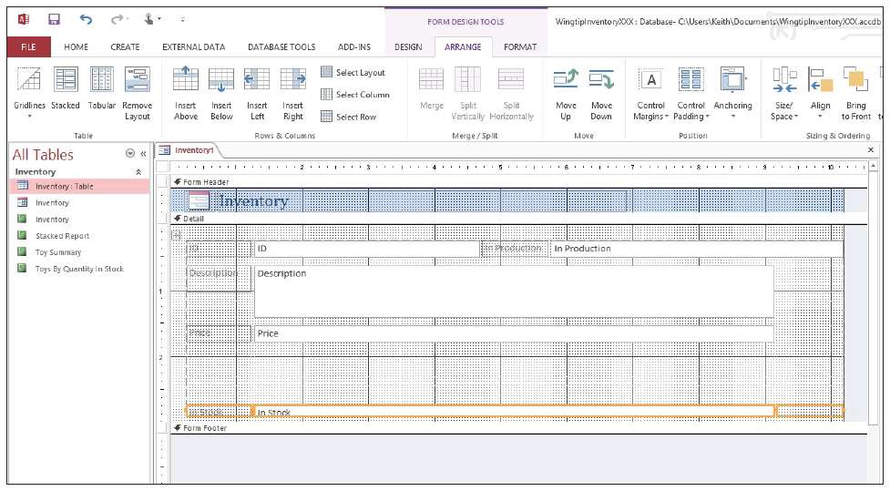
Step by Step: Arrange and Anchor Controls within a Layout
On the ARRANGE tab, in the Move group, click Move Down twice to move the In Stock control to the last cell row at the bottom of the layout, as shown below.
Notes:
Take Note: In Layout view, you can also use the tools on the ARRANGE tab to arrange controls within a layout for both forms and reports.

Slide 75
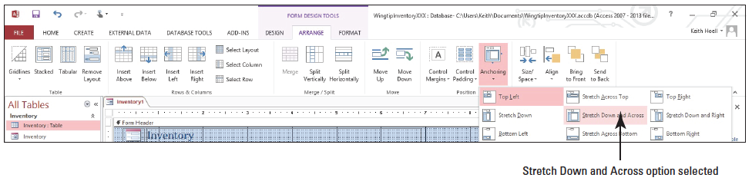
Step by Step: Arrange and Anchor Controls within a Layout
Click the Description field control to select it. On the ARRANGE tab in the Position group, click the Anchoring button. The Anchoring menu appears. Click the Stretch Down and Across option, as shown below. The Description field control as well as all the others will now automatically resize to display all their contained text, if necessary, when the Access window is made larger.

Slide 76
Step by Step: Arrange and Anchor Controls within a Layout
Click the In Stock field control and increase its height by positioning the pointer over the top-right corner of the control until a diagonal two-sided arrow appears and then clicking and dragging upward until the text is no longer obstructed.
Switch to Form view to display the new arrangement of the controls and resize the Access application window (not the form window) to see the controls stretch and shrink in conjunction with the window size.
SAVE the form as Modified Inventory Form and CLOSE it.
PAUSE. LEAVE the database open to use in the next exercise.

Slide 77
Step by Step: Arrange Control Alignment, Size, and Position
USE the database that is open from the previous exercise.
On the CREATE tab, in the Forms group, click the Form Design button. A new, blank form is created, and the Field List pane is displayed. (If it isn’t displayed, click the Add Existing Fields button in the Tools group on the DESIGN tab.)
Double-click the Description field to add it to the form.
Double-click the In Stock field to add it to the form.
Double-click the Price field to add it to the form.
Double-click the In Production field to add it to the form.

Slide 78
Step by Step: Arrange Control Alignment, Size, and Position
[Press and hold the Shift key] and click the Description, In Stock, and Price field controls to select them. The In Production field control should already be selected.
On the ARRANGE tab, in the Table group, click the Stacked button. The controls and labels are arranged in a stacked layout.
Click on a blank space on the design grid then select the In Production field control and label.

Slide 79
Step by Step: Arrange Control Alignment, Size, and Position
On the ARRANGE tab, in the Sizing & Ordering group, click the Size/Space button. In the Size category on the menu that appears, click the To Fit button. Notice all the field controls and labels are slightly resized in the layout based on the best fit of the text within the In Production field control and label since the layout forces all fields to conform to this action.
Select all the controls in the stacked layout (the labels and controls for the Description, In Stock, Price, and In Production controls).
On the ARRANGE tab, in the Table group, click the Remove Layout button.

Slide 80
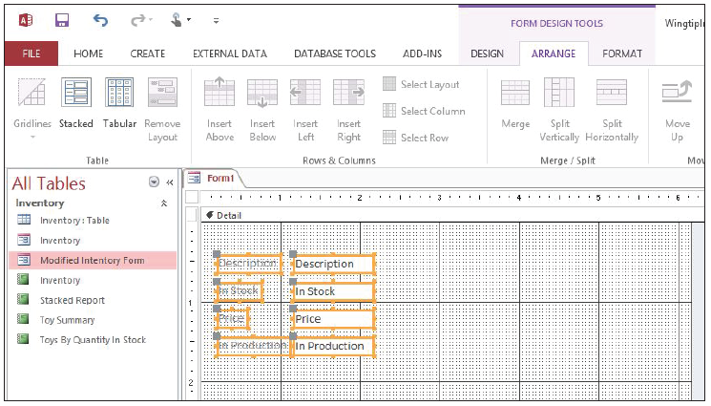
Step by Step: Arrange Control Alignment, Size, and Position
All the controls and labels should still be selected. On the ARRANGE tab, in the Sizing & Ordering group, click the Size/Space button. In the Size category on the menu that appears, click the To Fit button. Notice all the field controls independently change their width to best fit their text since they are no longer part of a layout. Your screen should look similar to the figure below.

Slide 81
Step by Step: Arrange Control Alignment, Size, and Position
With the controls and labels still selected, on the ARRANGE tab, in the Sizing & Ordering group, click the Align button. In the menu that appears, click the Right button. The labels are right-aligned to the controls.
Click and drag the ID field from the Field List pane to any blank spot on the design grid above the Description field.
Select the ID label and control and in the Sizing & Ordering group, click the Align button. In the menu that appears, click the Right button.

Slide 82
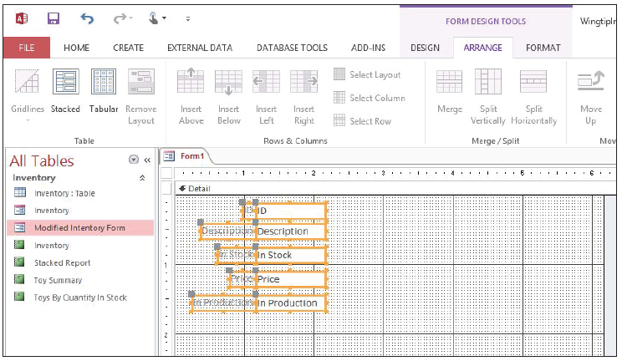
Step by Step: Arrange Control Alignment, Size, and Position
[Press and hold the Shift key] and click on both the labels and controls for all the controls. In the Sizing & Ordering group, click the Align button. In the menu, click the Left button. All the controls are left-aligned as a group.
In the Sizing & Ordering group, click the Align button. In the menu that appears, click the Right button. All the controls are now right-aligned as a group. Your screen should look similar to the figure above.

Slide 83
Step by Step: Arrange Control Alignment, Size, and Position
Select all the labels and controls, if necessary.
On the ARRANGE tab, in the Sizing & Ordering group, click the Size/Space button. In the Spacing category on the menu that appears, click the Equal Vertical button. Notice that the vertical space between the controls is now equal.
Click on a blank space on the design grid.
On the ARRANGE tab, in the Sizing & Ordering group, click the Size/Space button. In the Grid category on the menu that appears, click the Grid button. The design grid disappears.

Slide 84
Step by Step: Arrange Control Alignment, Size, and Position
Click the Grid button again. The design grid appears.
Click on a blank space on the design grid and drag to draw a box around the labels and controls so they are all selected, or [press and hold the Shift key] and select each label and control.
On the ARRANGE tab, in the Sizing & Ordering group, click the Align button. In the menu that appears, click the To Grid button. Notice the control and labels slightly move. The upper-left corners of all the labels are now aligned to their nearest grid points.

Slide 85
Step by Step: Arrange Control Alignment, Size, and Position
On the ARRANGE tab, in the Sizing & Ordering group, click the Size/Space button. In the Grid category on the menu that appears, click the Ruler button. The rulers disappear.
Click the Ruler button again. The rulers reappear.
SAVE the form as Arranged Inventory Form and CLOSE it.
PAUSE. LEAVE the database open to use in the next exercise.

Slide 86
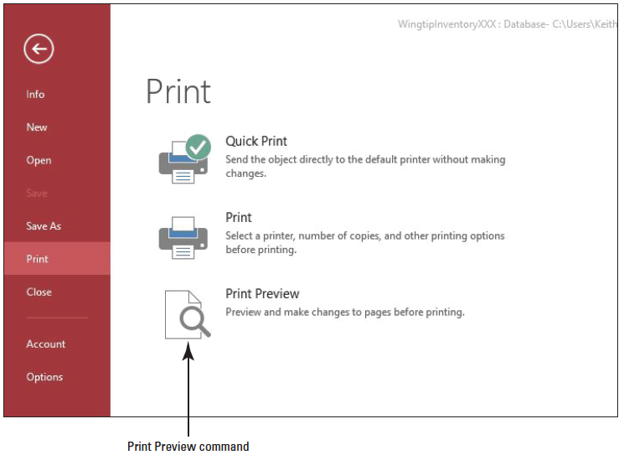
Step by Step: Adjust Page Margins and Change Page Orientation for Forms and Reports
USE the database that is open from the previous exercise.
Click the Modified Inventory Form in the Navigation Pane and click the FILE tab.
On the FILE tab, click the Print button to display the Print menu, as shown above.

Slide 87
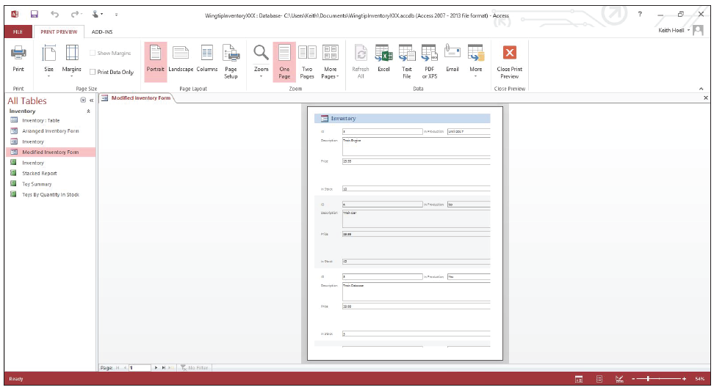
Step by Step: Adjust Page Margins and Change Page Orientation for Forms and Reports
Click the Print Preview command. The Print Preview screen appears with a preview of the form, as shown below. Notice the form’s field borders exceed the width of the right margin.

Slide 88
Step by Step: Adjust Page Margins and Change Page Orientation for Forms and Reports
In the Page Layout group, click the Landscape button to display the form in landscape view. Notice some of the form’s field borders still exceed the width of the right margin.

Slide 89

Step by Step: Adjust Page Margins and Change Page Orientation for Forms and Reports
In the Page Size group, click the Margins button. On the Margins menu that appears, click the Narrow option. The form’s field borders have been adjusted and are now within the right margin, and the print layout now appears complete. Your screen should resemble the form as shown below. In the Close Preview group, click the Close Print Preview button to return to the Access database screen.

Slide 90

Step by Step: Adjust Page Margins and Change Page Orientation for Forms and Reports
Open the Toys By Quantity In Stock report.
On the HOME tab, in the Views group, click the lower half of the View button and select Print Preview from the menu. The report is displayed in Print Preview, as shown above. Notice the Price field header and data in the last column exceed the width of the right margin.

Slide 91
Step by Step: Adjust Page Margins and Change Page Orientation for Forms and Reports
On the PRINT PREVIEW tab, in the Page Size group, click the Margins button and select Narrow from the menu that appears. The Price field header and data are now completely visible.
On the PRINT PREVIEW tab, click the Close Print Preview button to return to Report view.
CLOSE the report.
CLOSE the database.

Slide 92
Skill Summary

